Slide 1
Chapter 30
Oscillators

Slide 2
Objectives
After completing this chapter, you will be able to:
  Describe an oscillator and its purpose
  Identify the main requirements of an oscillator
  Explain how a tank circuit operates and describe its relationship to an oscillator
  Draw a block diagram of an oscillator

Slide 3
Objectives (cont’d.)
  Identify LC, crystal, and RC sinusoidal oscillator circuits
  Identify nonsinusoidal relaxation oscillator circuits
  Draw examples of sinusoidal and nonsinusoidal oscillators

Slide 4
Fundamentals of Oscillators
Oscillator
  A circuit that generates a repetitive AC signal
  Output may be sinusoidal, rectangular, or sawtooth waveforms
Main requirement
  Output must not vary in frequency or amplitude

Slide 5
Fundamentals of Oscillators
(cont’d.)
Tank circuit
  Formed when an inductor and capacitor are connected in parallel
  Oscillates when excited by external DC source
  Oscillation dampened by resistance of circuit
  Oscillation maintained by positive feedback

Slide 6
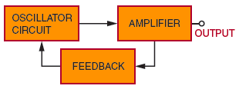
Fundamentals of Oscillators
(cont’d.)
Figure 30-1. Block diagram of an oscillator.

Slide 7
Sinusoidal Oscillators
Sinusoidal oscillators
  Produce a sine-wave output
Three basic types
  LC oscillators
  Crystal oscillators
  RC oscillators

Slide 8
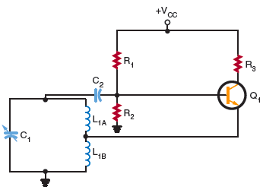
Sinusoidal Oscillators (cont’d.)
Figure 30-2. Series-fed Hartley oscillator.

Slide 9
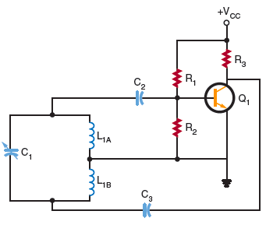
Sinusoidal Oscillators (cont’d.)
Figure 30-3. Shunt-fed Hartley oscillator.

Slide 10
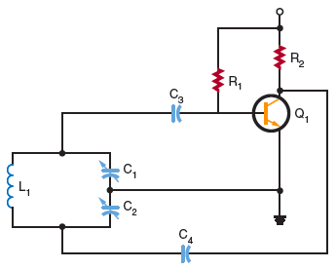
Sinusoidal Oscillators (cont’d.)
Figure 30-4. Colpitts oscillator.

Slide 11
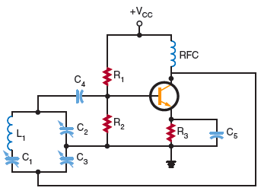
Sinusoidal Oscillators (cont’d.)
Figure 30-5. Clapp oscillator.

Slide 12
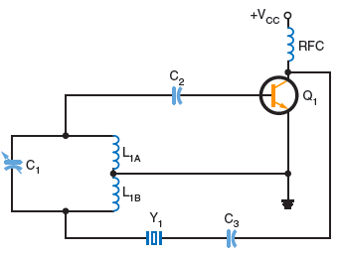
Sinusoidal Oscillators (cont’d.)
Figure 30-7. Crystal shunt-fed Hartley oscillator.

Slide 13
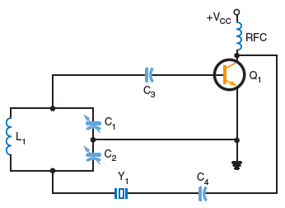
Sinusoidal Oscillators (cont’d.)
Figure 30-8. Colpitts crystal oscillator.

Slide 14
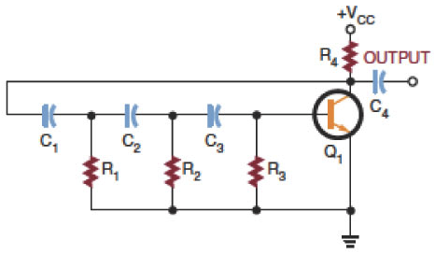
Sinusoidal Oscillators (cont’d.)
Figure 30-11. Phase-shift oscillator.

Slide 15
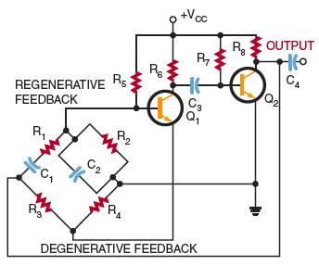
Sinusoidal Oscillators (cont’d.)
Figure 30-12. Wien-bridge oscillator.

Slide 16
Nonsinusoidal Oscillators
Nonsinusoidal oscillators
  Do not produce a sine-wave output
  Outputs include square, sawtooth, rectangular, or triangular waveforms, or a combination of two waveforms
  Form of relaxation oscillator

Slide 17
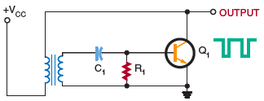
Nonsinusoidal Oscillators
(cont’d.)
Figure 30-14. Blocking oscillator.

Slide 18
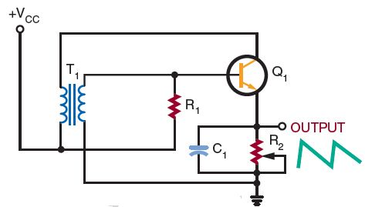
Nonsinusoidal Oscillators
(cont’d.)
Figure 30-15. Sawtooth waveform generated by a blocking oscillator.

Slide 19
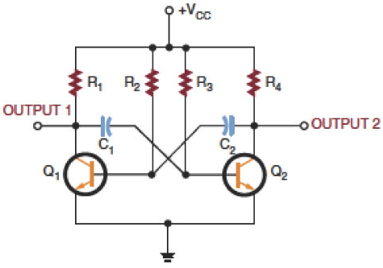
Nonsinusoidal Oscillators
(cont’d.)
Figure 30-16. Free-running multivibrator.

Slide 20
Summary
An oscillator is a nonrotating device for producing alternating current
Main requirement of an oscillator
  That output be uniform and not vary in frequency or amplitude
A tank circuit oscillates when an external voltage source is applied

Slide 21
Summary (cont’d.)
The three basic types of sinusoidal oscillators
  LC oscillators, crystal oscillators, and RC oscillators
Nonsinusoidal oscillators do not produce a sine-wave output
A relaxation oscillator is the basis of all nonsinusoidal oscillators

